Slide 1
The Final Piece of the Puzzle: 3D Inversion of Ultra-Deep Azimuthal Resistivity LWD Data
SPWLA
Distinguished
Speaker
2019-2020
Nigel Clegg, Timothy Parker, Bronwyn Djefel (Halliburton), Luc Monteilhet (ConocoPhillips), David Marchant (Computational Geosciences Inc.)

Slide 2
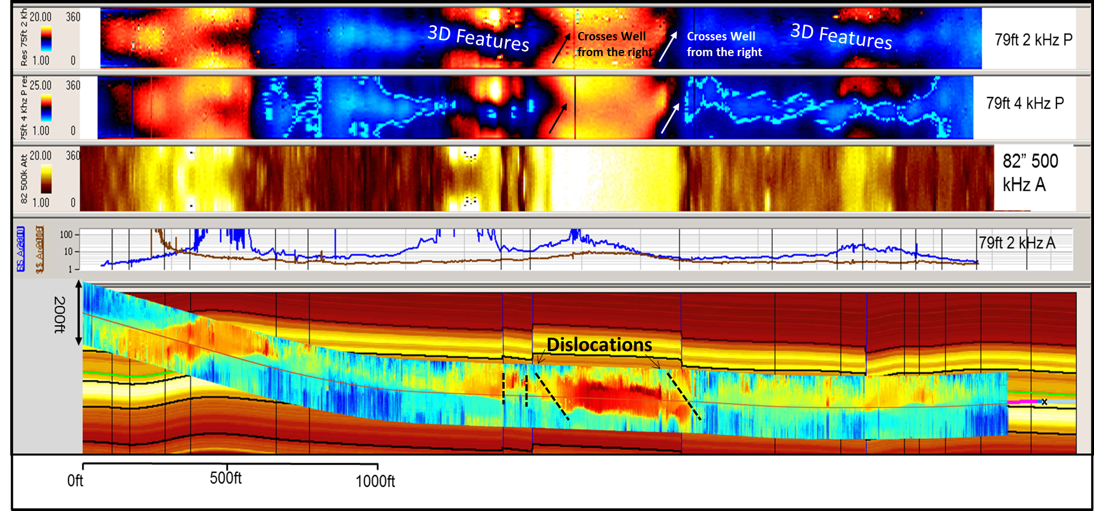
1D Inversion of Case Study
Low Res Bttm Left
Low Res Bttm Left

Slide 3
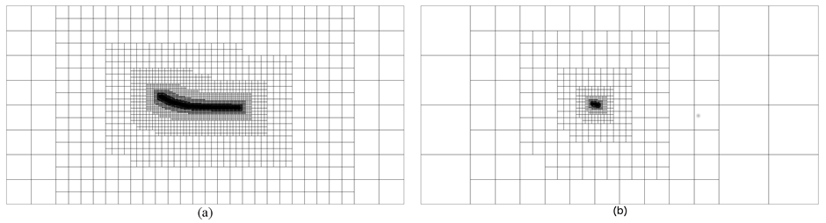
Cross Sections of 2 Octree Meshes
Global Mesh
Local Mesh
Discretizes the entire well path and stores the inverse model
Simulates the response and sensitivities of a single transmitter location at a single frequency

Slide 4
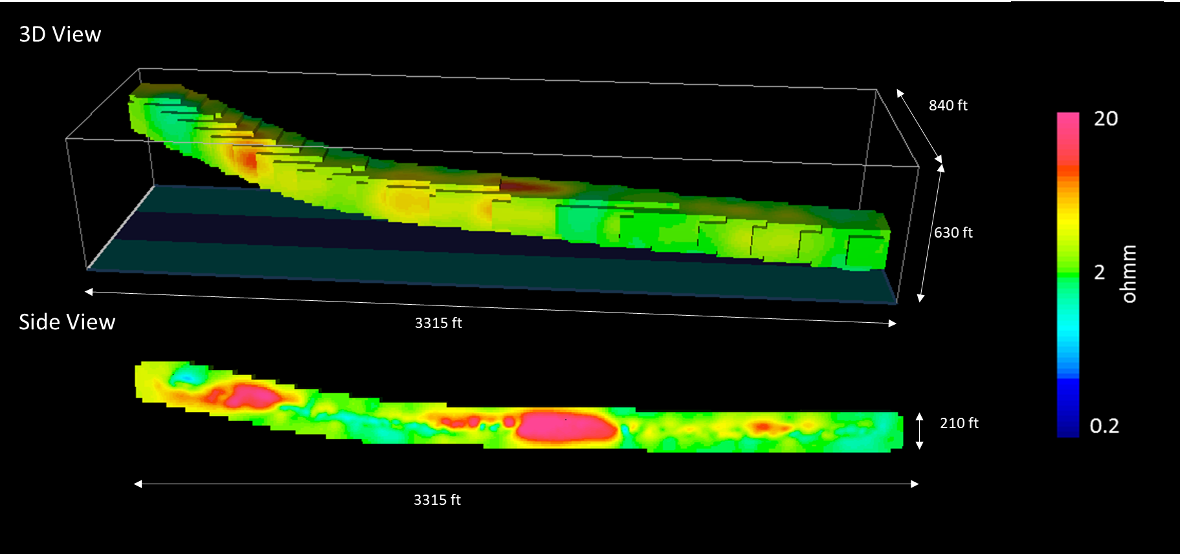
3D Data

Slide 5
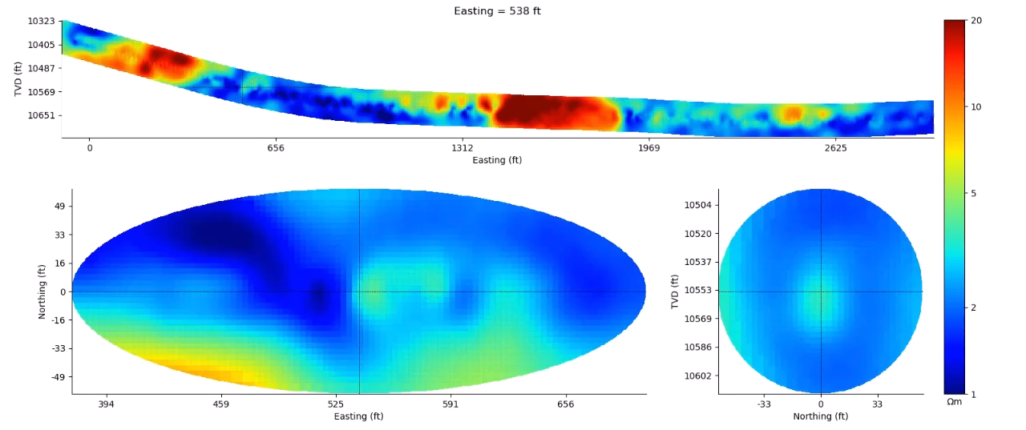
Video Fly Through of 3D Data

Slide 6
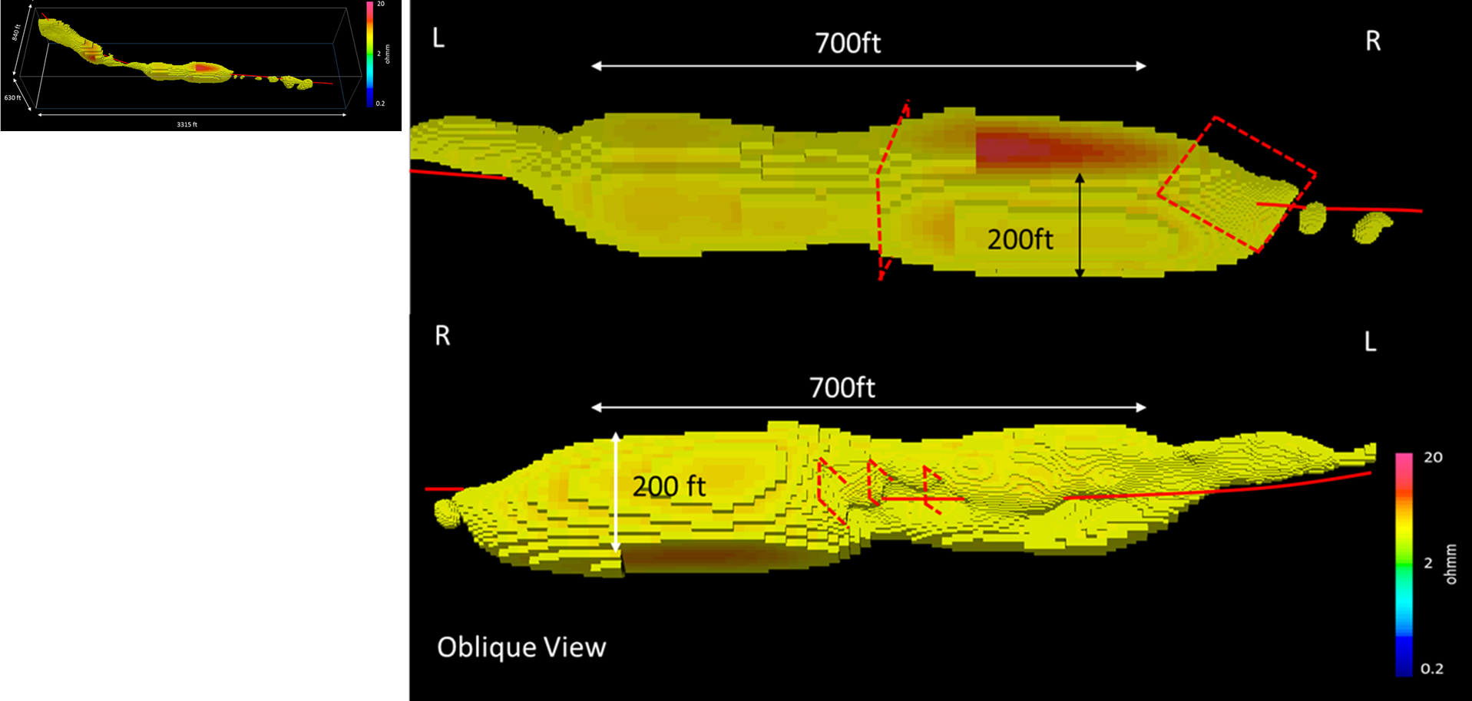
3D Inversion, Cut Off at 4 ohm.m

Slide 7
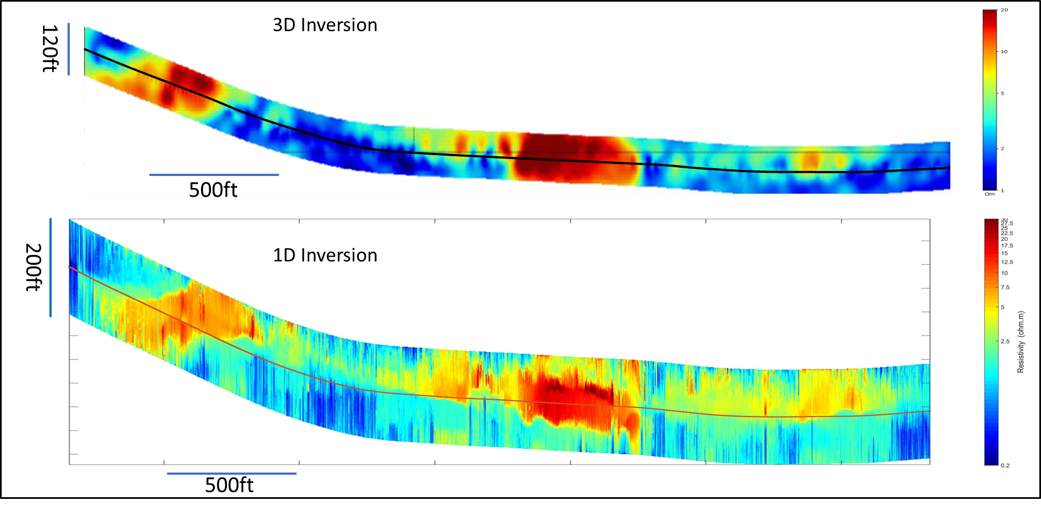
Qualifying 3D Inversion

Slide 8
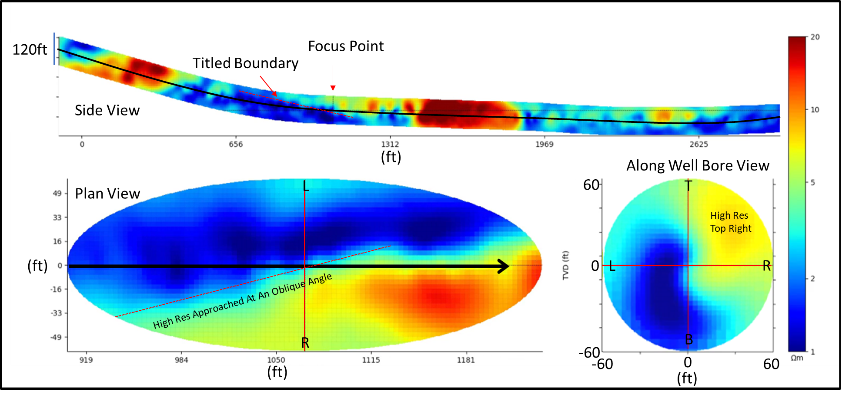
Entry Into Oil Zone

Slide 9
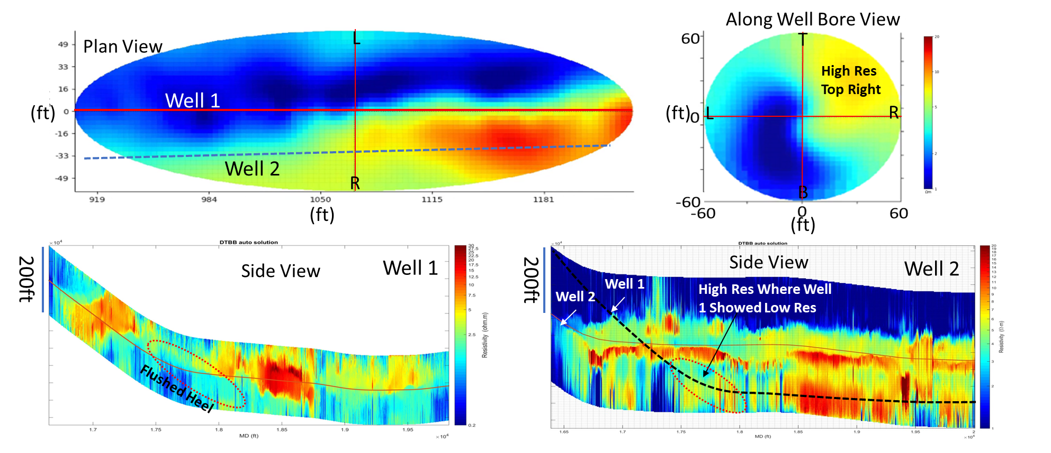
1D Inversion Results for Wells 1 and 2

Slide 10
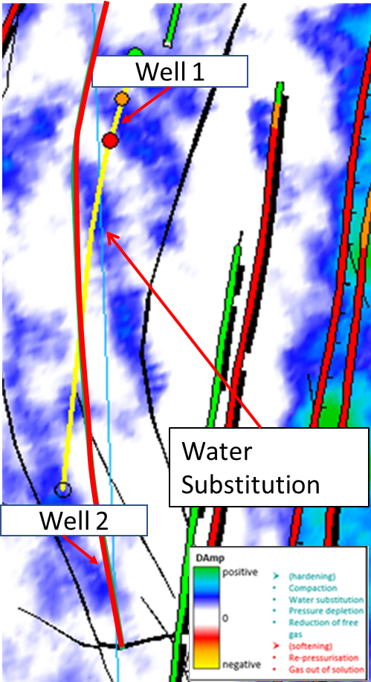
4D Seismic

Slide 11
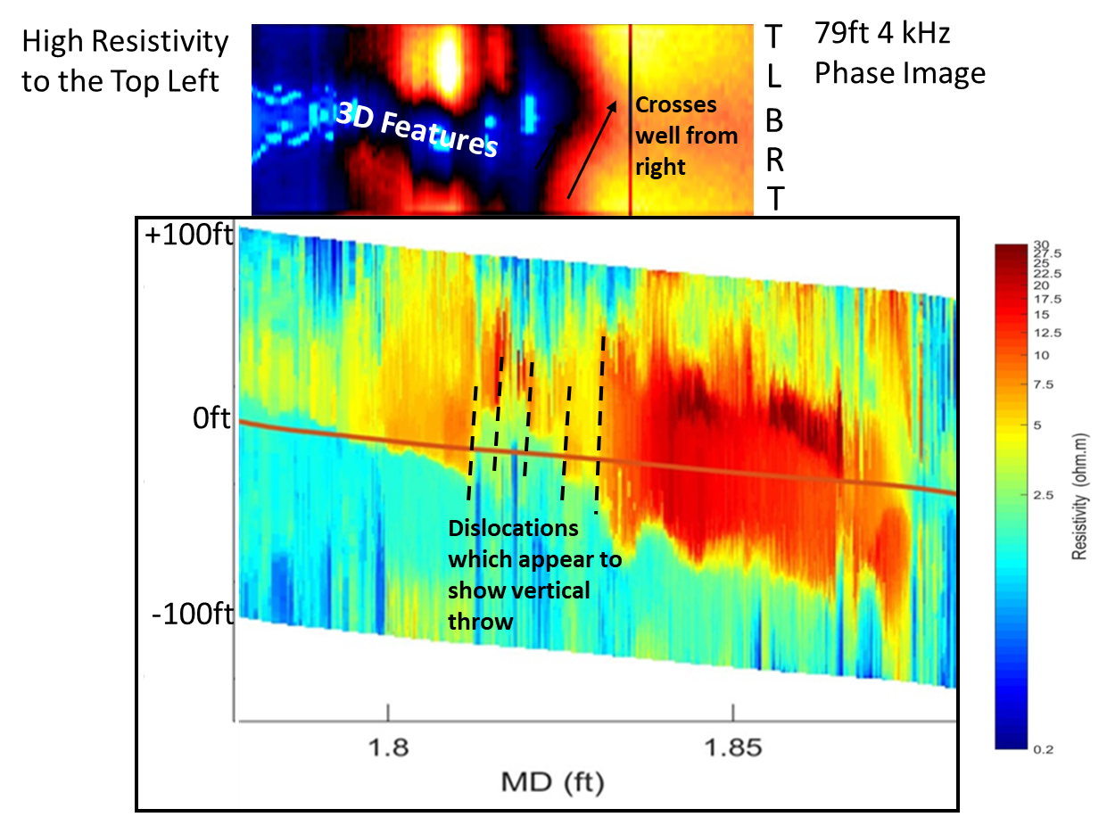
Central Portion of Well

Slide 12
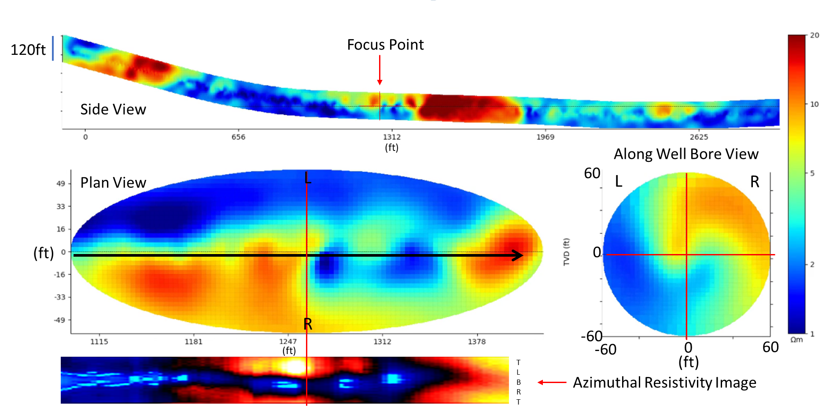
Central Portion of Well

Slide 13
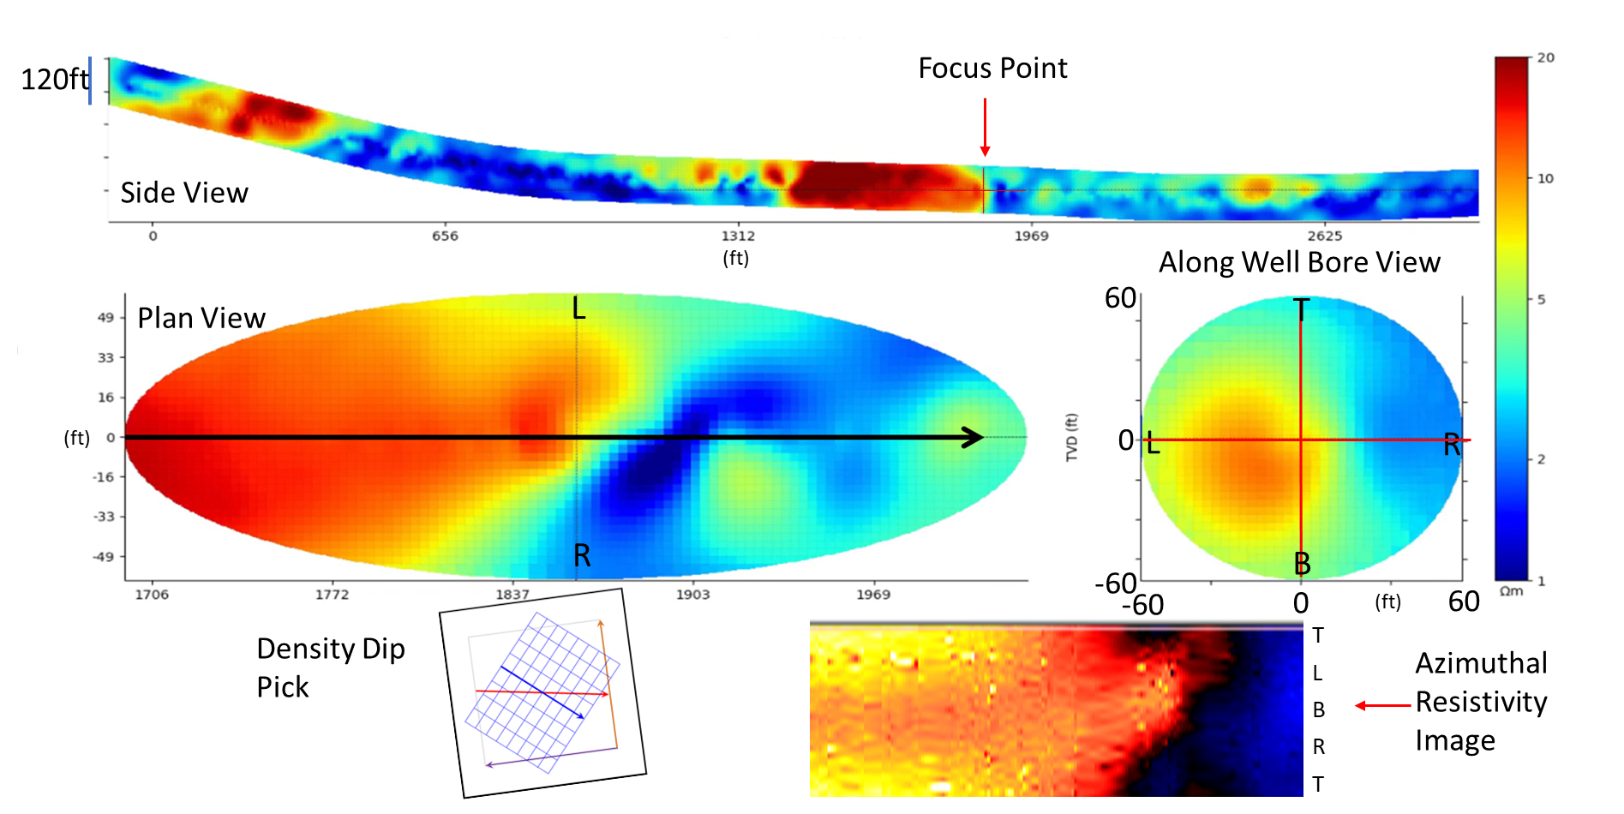
Fault Terminating Oil Zone

Slide 14
Summary
3D inversion validated with 1D inversion, azimuthal resistivity and density images, and information from the 4D seismic.
3D inversion shows the structural complexity in a way that is easy to understand.
This will have a significant impact on well placement and will increase reservoir understanding.

Slide 15




Acknowledgements
PL018 partnership
ConocoPhillips Skandinavia AS
Total E&P Norge AS
Vår Energi AS
Equinor Energy AS
Petoro AS
Colleagues at ConocoPhillips
Halliburton
Ultra Deep Resistivity Team
Computational Geosciences Inc

Slide 16
SPWLA MEMEBRSHIP Advantages
Join today! www.spwla.org
Benefits
Activities
Monthly free webinars
Petrophysics Journal
Registration Savings on Conferences
Access to On-line Educational Resources (SPWLA Nuggets of Wisdom)
Petrophysics focused information
SPWLA Foundation Scholarship Program
Sponsored Student Membership... MUCH more!
35 International Chapters (10 US based)
18 Student Chapters
9 Chapters-at-large (SIGs and Society of Core Analysts – SCA)
Annual Symposium Held Alternatively in the US and Overseas
Annual Distinguished Speaker Program and Global Distinguished Speakers
Topical Conferences
Many Local Chapter Activities

Slide 17

61st ANNUAL SPWLA Symposium
Banff, Alberta, Canada June 20-24, 2020

